Slide 1
DBMS Relational Model and Relational Algebra

Slide 2
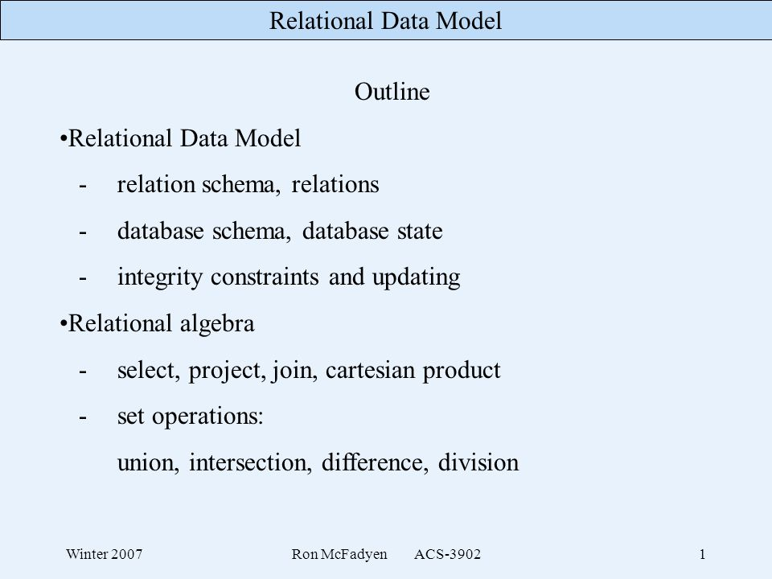

Slide 3
Relational Algebra
Relational algebra is a procedural query language, which takes instances of relations as input and yields instances of relations as output.
It uses operators to perform queries. An operator can be either unary or binary.
Relational algebra is performed recursively on a relation and intermediate results are also considered relations.
Relational algebra mainly provides theoretical foundation for relational databases and SQL.

Slide 4
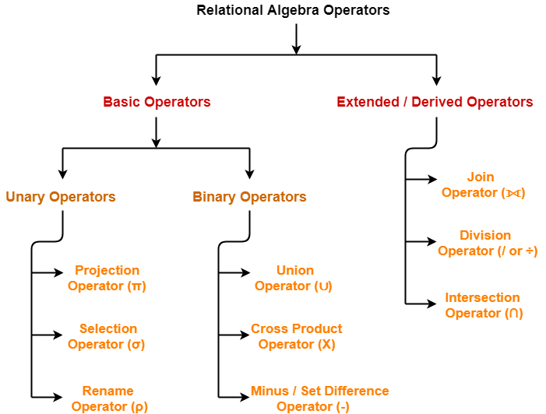

Slide 5
Selection (σ)
Selection is used to select required tuples of the relations.

Slide 6
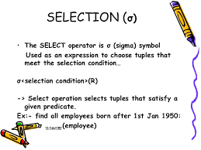

Slide 7
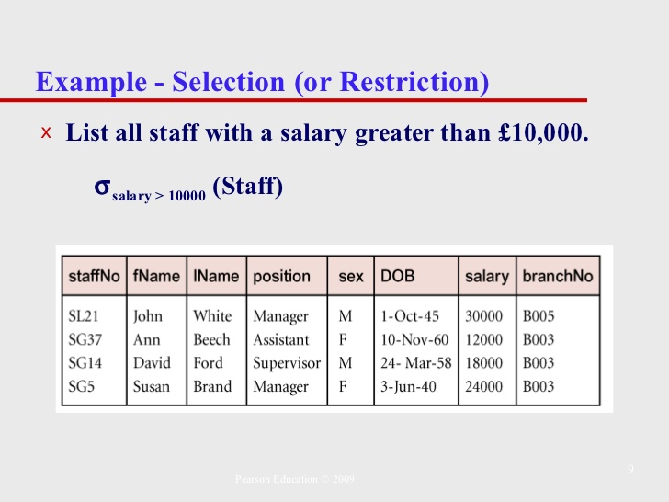

Slide 8
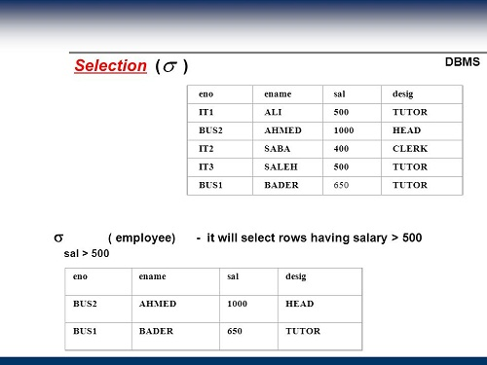

Slide 9
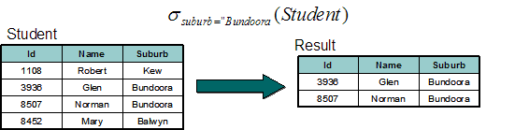

Slide 10
Projection (π)
Projection is used to project required column data from a relation.
extract the values of specified attributes to eliminates duplicate values. (pi) symbol is used to choose attributes from a relation.
This operator helps you to keep specific columns from a relation and discards the other columns.

Slide 11
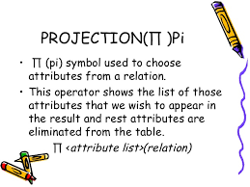

Slide 12
R
(A B C)
----------
1 2 4
2 2 3
3 2 3
4 3 4
π (BC)
B C
-----
2 4
2 3
3 4

Slide 13
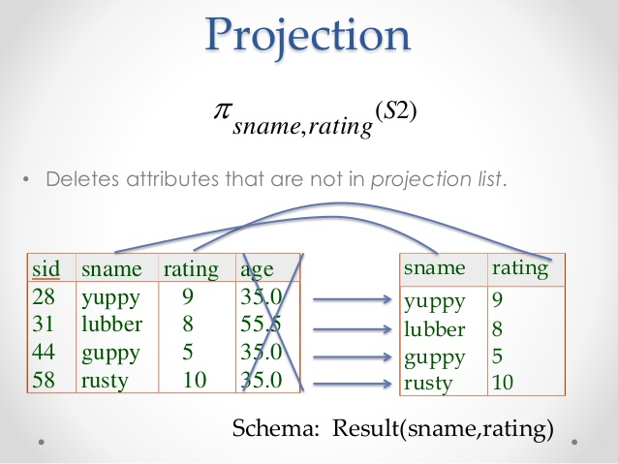

Slide 14
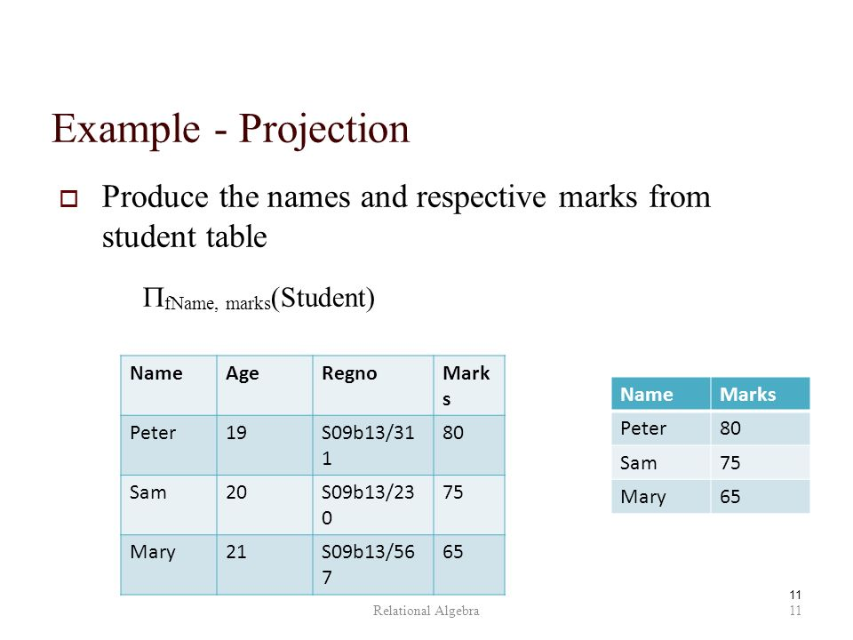

Slide 15
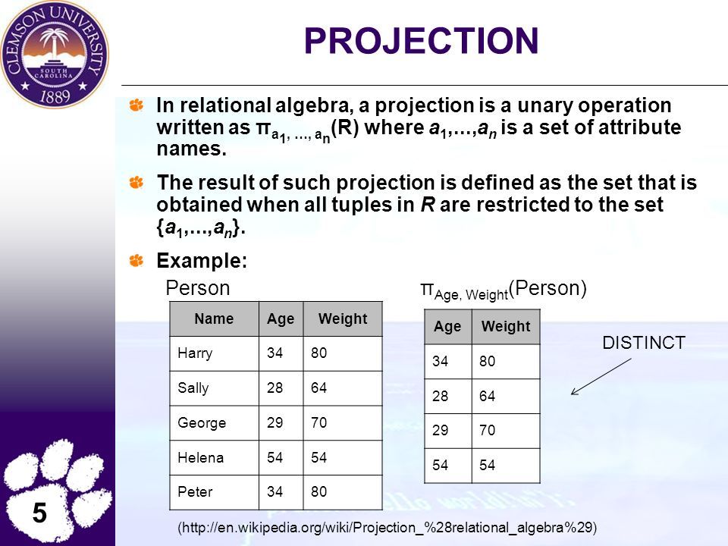

Slide 16
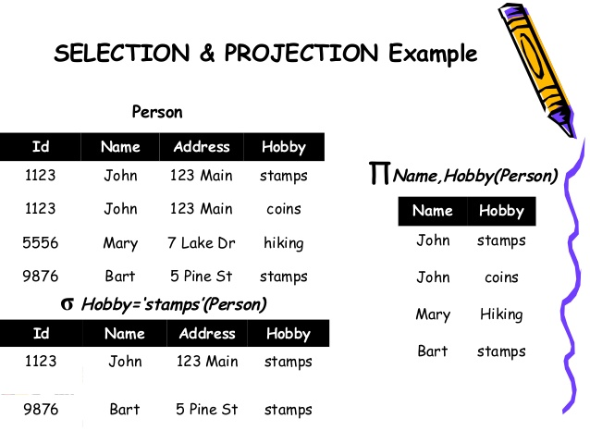

Slide 17
Rename (ρ) -> (Rho )
Rename is a unary operation used for renaming attributes (column) of a relation.

Slide 18
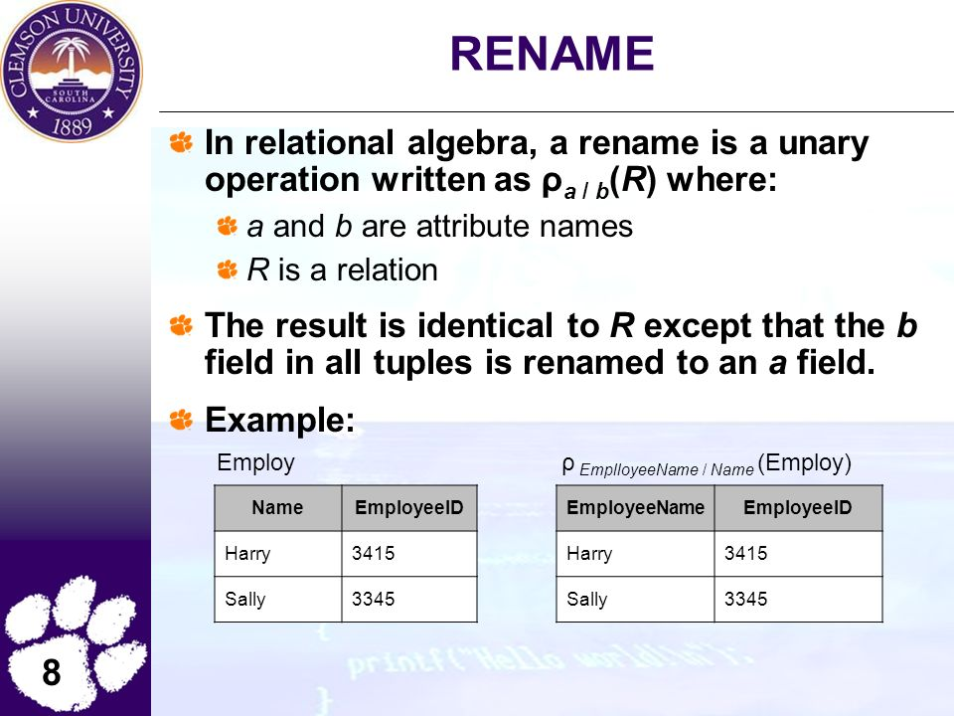

Slide 19
Union (U)
Union operation in relational algebra is same as union operation in set theory, only constraint is for union of two relation both relation must have same set of Attributes

Slide 20
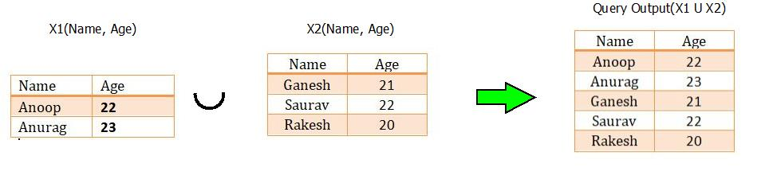

Slide 21
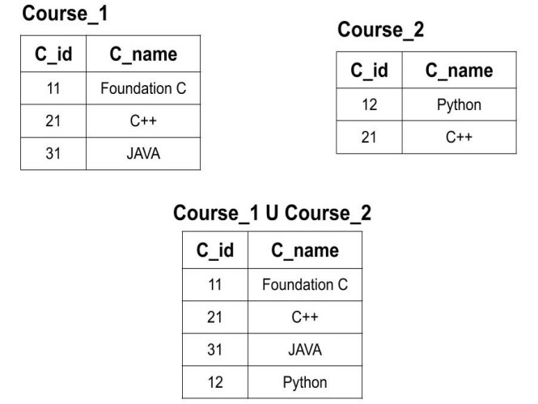

Slide 22
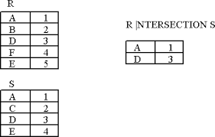
Intersection (Common)

Slide 23
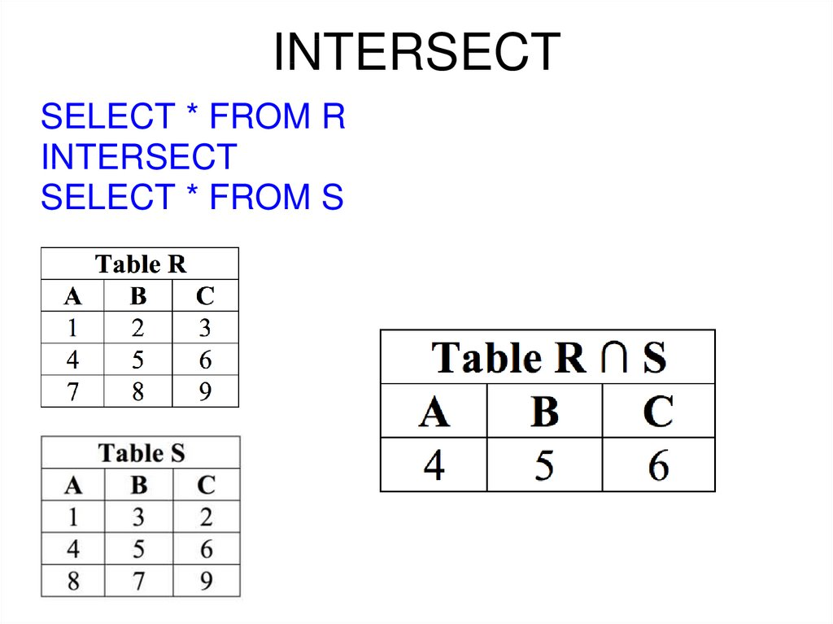

Slide 24
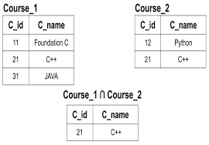

Slide 25
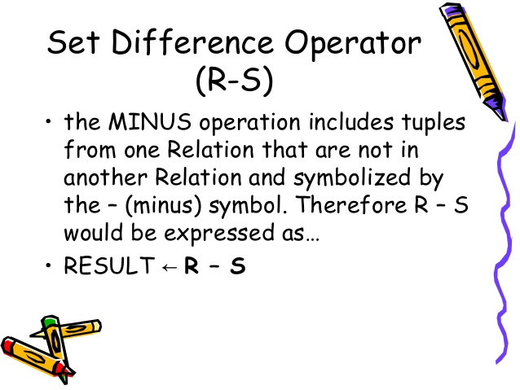

Slide 26
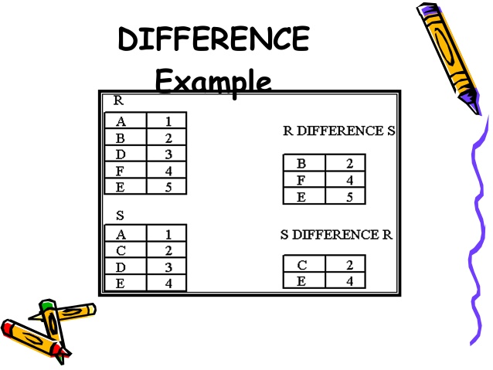

Slide 27
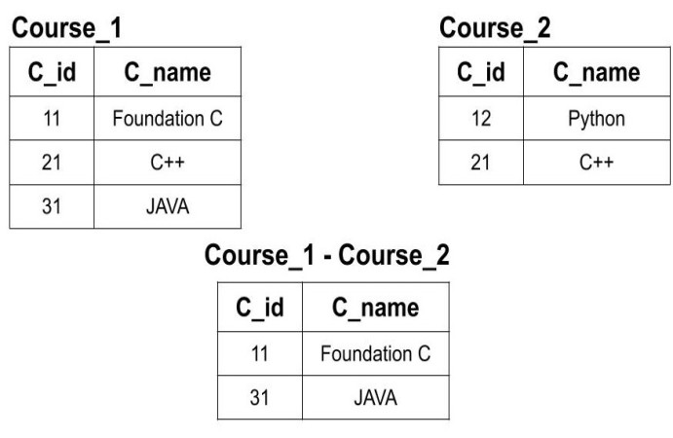

Slide 28
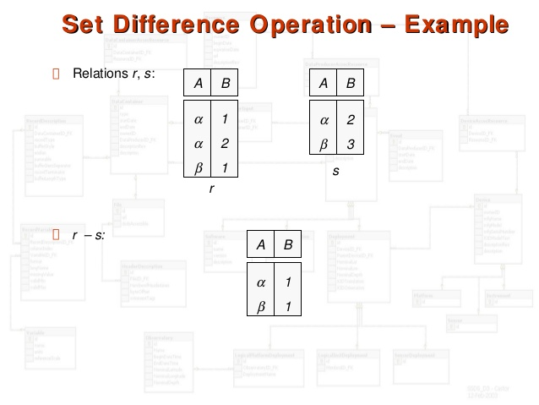

Slide 29
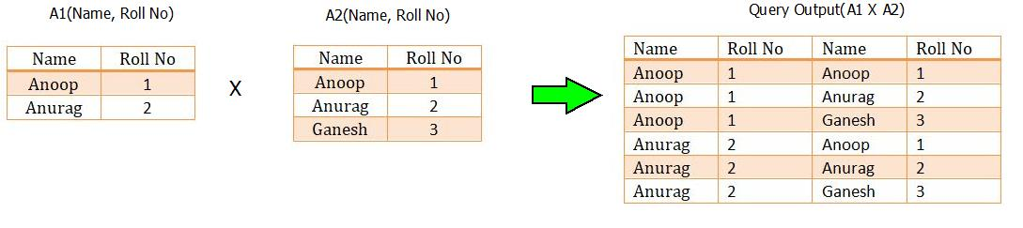
Cartesian Product

Slide 30
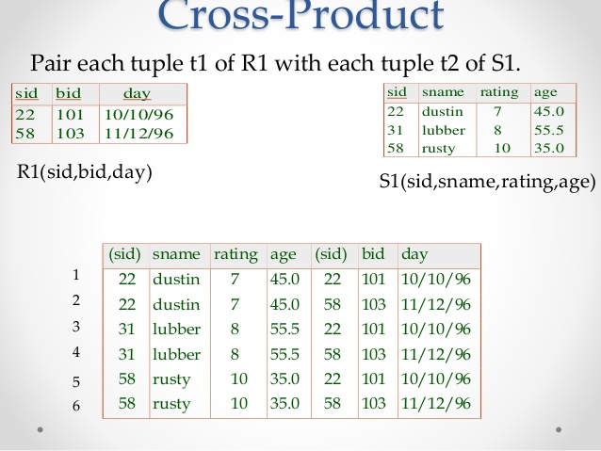

Slide 31
Division
Suitable for queries that includes "For all"
A Divides B returns those tuples from A which associate to every B tuple.
6 Divide 2

Slide 32
Get the name of customers who bought every product type that company sells.

Slide 33
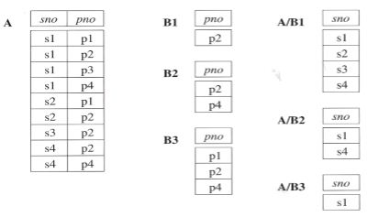

Slide 34
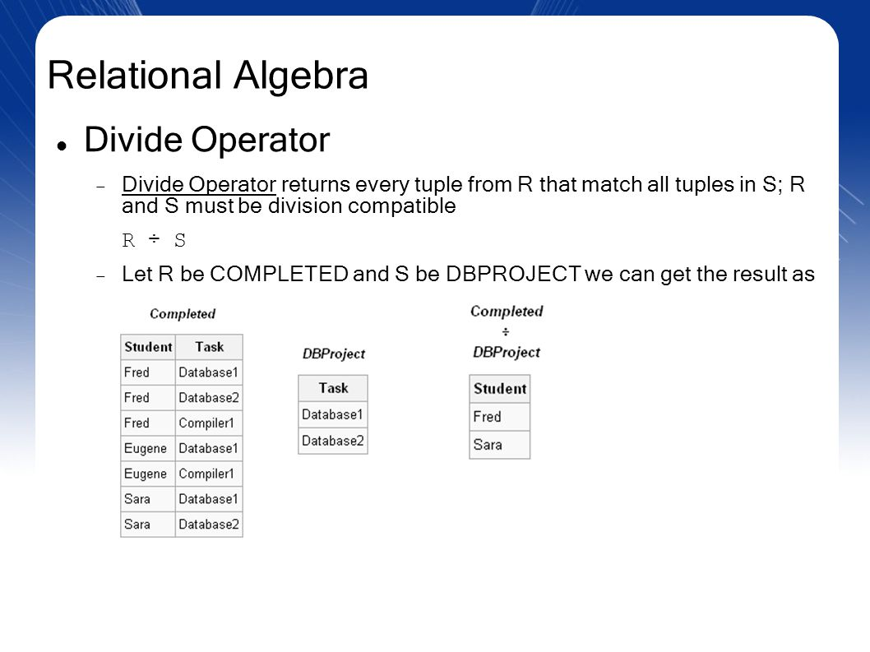

Slide 35
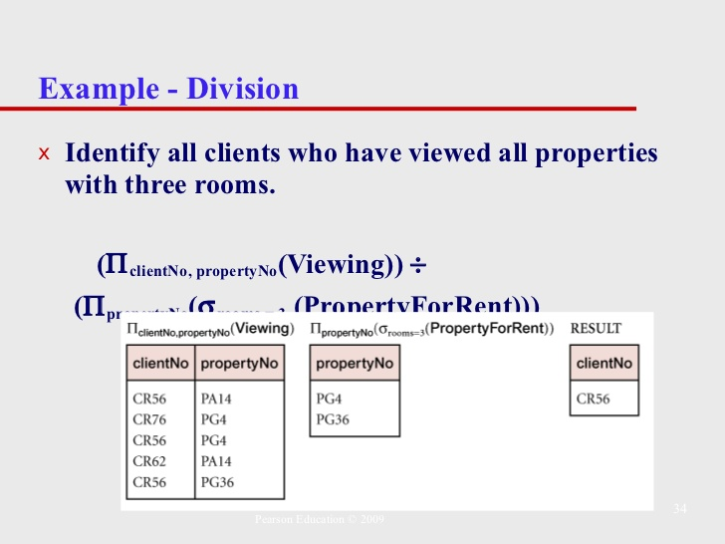

Slide 36
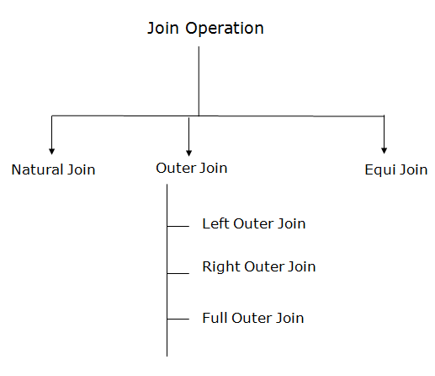

Slide 37
A Join operation combines related tuples from different relations, if and only if a given join condition is satisfied.
It is denoted by ⋈.
JOIN operation also allows joining variously related tuples from different relations.

Slide 38
Join
EMP_CODE | EMP_NAME
101 | Stephan
102 | Jack
103 | Harry
EMP_CODE | SALARY
101 | 50000
102 | 30000
103 | 25000
(EMPLOYEE ⋈ SALARY)
EMP_CODE | EMP_NAME | SALARY
101 | Stephan | 50000
102 | Jack | 30000
103 | Harry | 25000

Slide 39
Natural Join
Natural join can join tables based on the common columns in the tables being joined.
Combines cross product and selection into one operation
A natural join returns all rows by matching values in common columns having same name and data type of columns and that column should be present in both tables.
All non matching tuples are ignored.
If two relations have no attributes in common then their natural join is caretisian product

Slide 40
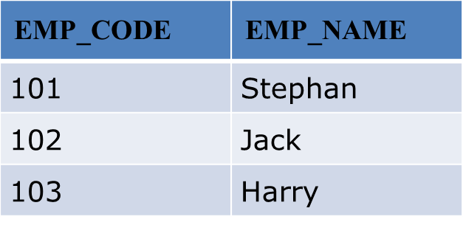
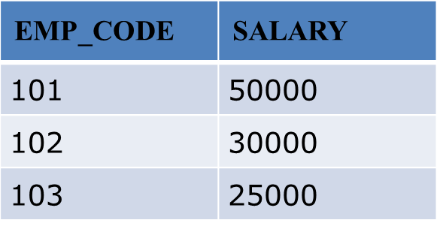
∏EMP_NAME, SALARY (EMPLOYEE ⋈ SALARY)
EMP_NAME | SALARY
Stephan | 50000
Jack | 30000
Harry | 25000

Slide 41
Eid | Ename | Did
1 | Rohan | 10
2 | Mohan | 30
3 | Sohan | 50
Did | Dname
10 | IT
30 | HR
40 | TIS
Employee ⋈ Department
Eid | Ename | Did | Did | Dname
1 | Rohan | 10 | 10 | IT
2 | Mohan | 30 | 30 | HR

Slide 42
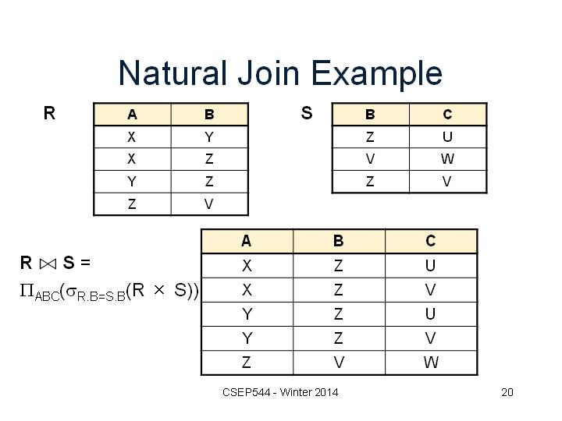

Slide 43
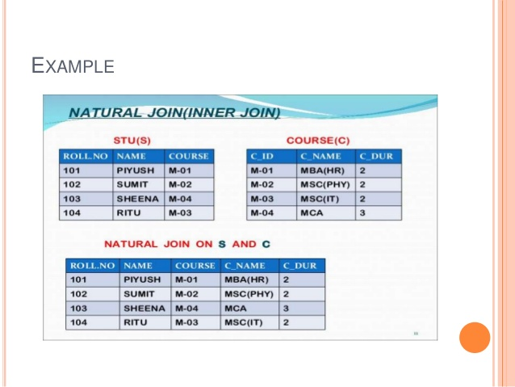

Slide 44
Equi join(Inner join)
It is the most common join.
It is based on matched data as per the equality condition.
The equi join uses the comparison operator(=).
All non-matching tuples are removed.

Slide 45
Equi Join
CLASS_ID | NAME
1 | John
2 | Harry
4 | Jackson
PRODUCT_ID | CITY
1 | Delhi
2 | Mumbai
3 | Noida
CUSTOMER ⋈customer.class_ID=Product.Product_ID PRODUCT
CLASS_ID | NAME | PRODUCT_ID | CITY
1 | John | 1 | Delhi
2 | Harry | 2 | Mumbai

Slide 46
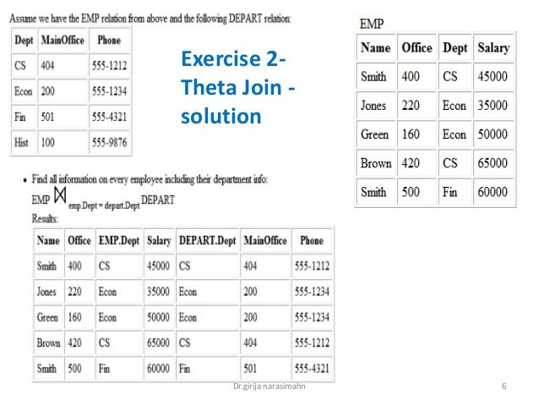

Slide 47
Outer Join
In Inner join rows that do not satisfy the join conditions are discarded.
Outer join joins two tables although there is no match between two joining tables.

Slide 48
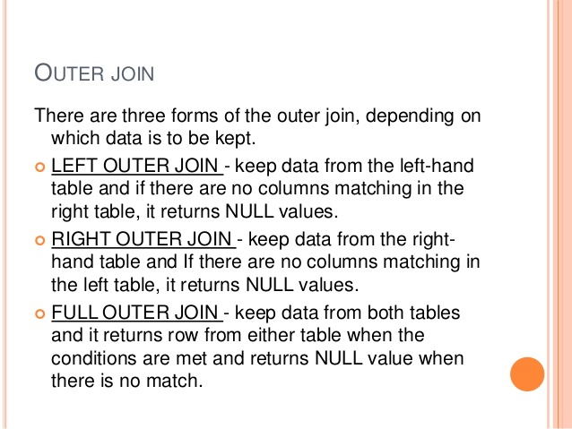

Slide 49
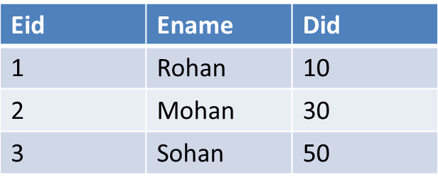
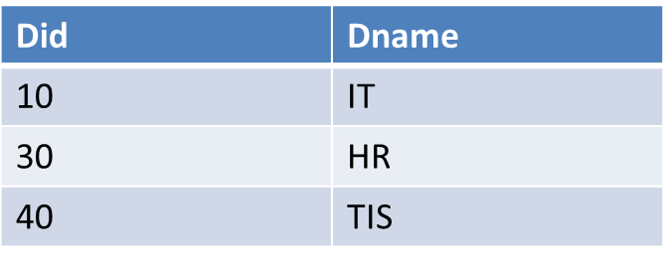
Left Outer Join
Eid | Ename | Did | Did | Dname
1 | Rohan | 10 | 10 | IT
2 | Mohan | 30 | 30 | HR
3 | Sohan | 50 | NULL | NULL

Slide 50
In the right outer join, operation allows keeping all tuple in the right relation.

Slide 51
Right Outer Join
Eid | Ename | Did | Did | Dname
1 | Rohan | 10 | 10 | IT
2 | Mohan | 30 | 30 | HR
NULL | NULL | NULL | 40 | TIS

Slide 52
In a full outer join, all tuples from both relations are included in the result irrespective of the matching condition.

Slide 53
Full Outer Join
Eid | Ename | Did | Did | Dname
1 | Rohan | 10 | 10 | IT
2 | Mohan | 30 | 30 | HR
3 | Sohan | 50 | NULL | NULL
NULL | NULL | NULL | 40 | TIS

Slide 54
The primary difference between an inner(Equi) and natural join is that inner joins have an explicit join condition,
whereas the natural join’s conditions are formed by matching all pairs of columns in the tables that have the same name and compatible data types, making natural joins equi-joins because join condition are equal between common columns. (If the data types are incompatible, Vertica returns an error.)

Slide 55
Inner Join
This is the most used join in the SQL. this join returns only those records/rows that match/exist in both the database tables.

Slide 56
Equi Join
Equi join is a special type of join in which we use only an equality operator.
Hence, when you make a query for join using equality operator then that join query comes under Equi join.
The equi join creates a JOIN for equality or matching of the single or multiple column values of the relative tables.
Apart from that, the equi join also create the JOIN by using JOIN along with the ON clause and then providing the names of the columns with their relative tables to check equality using the equal operator.

Slide 57
Natural Join
A natural join is a type of equi join which occurs implicitly by comparing all the same names columns in both tables.
The join result has only one column for each pair of equally named columns.
In other words, the Natural Join helps to join the two tables based on the same attribute name and the datatypes.
The result of the JOIN table will contain all the attributes of both tables but keep only one copy of each common column accordingly.

Slide 58
Thank you !

